Slide 1
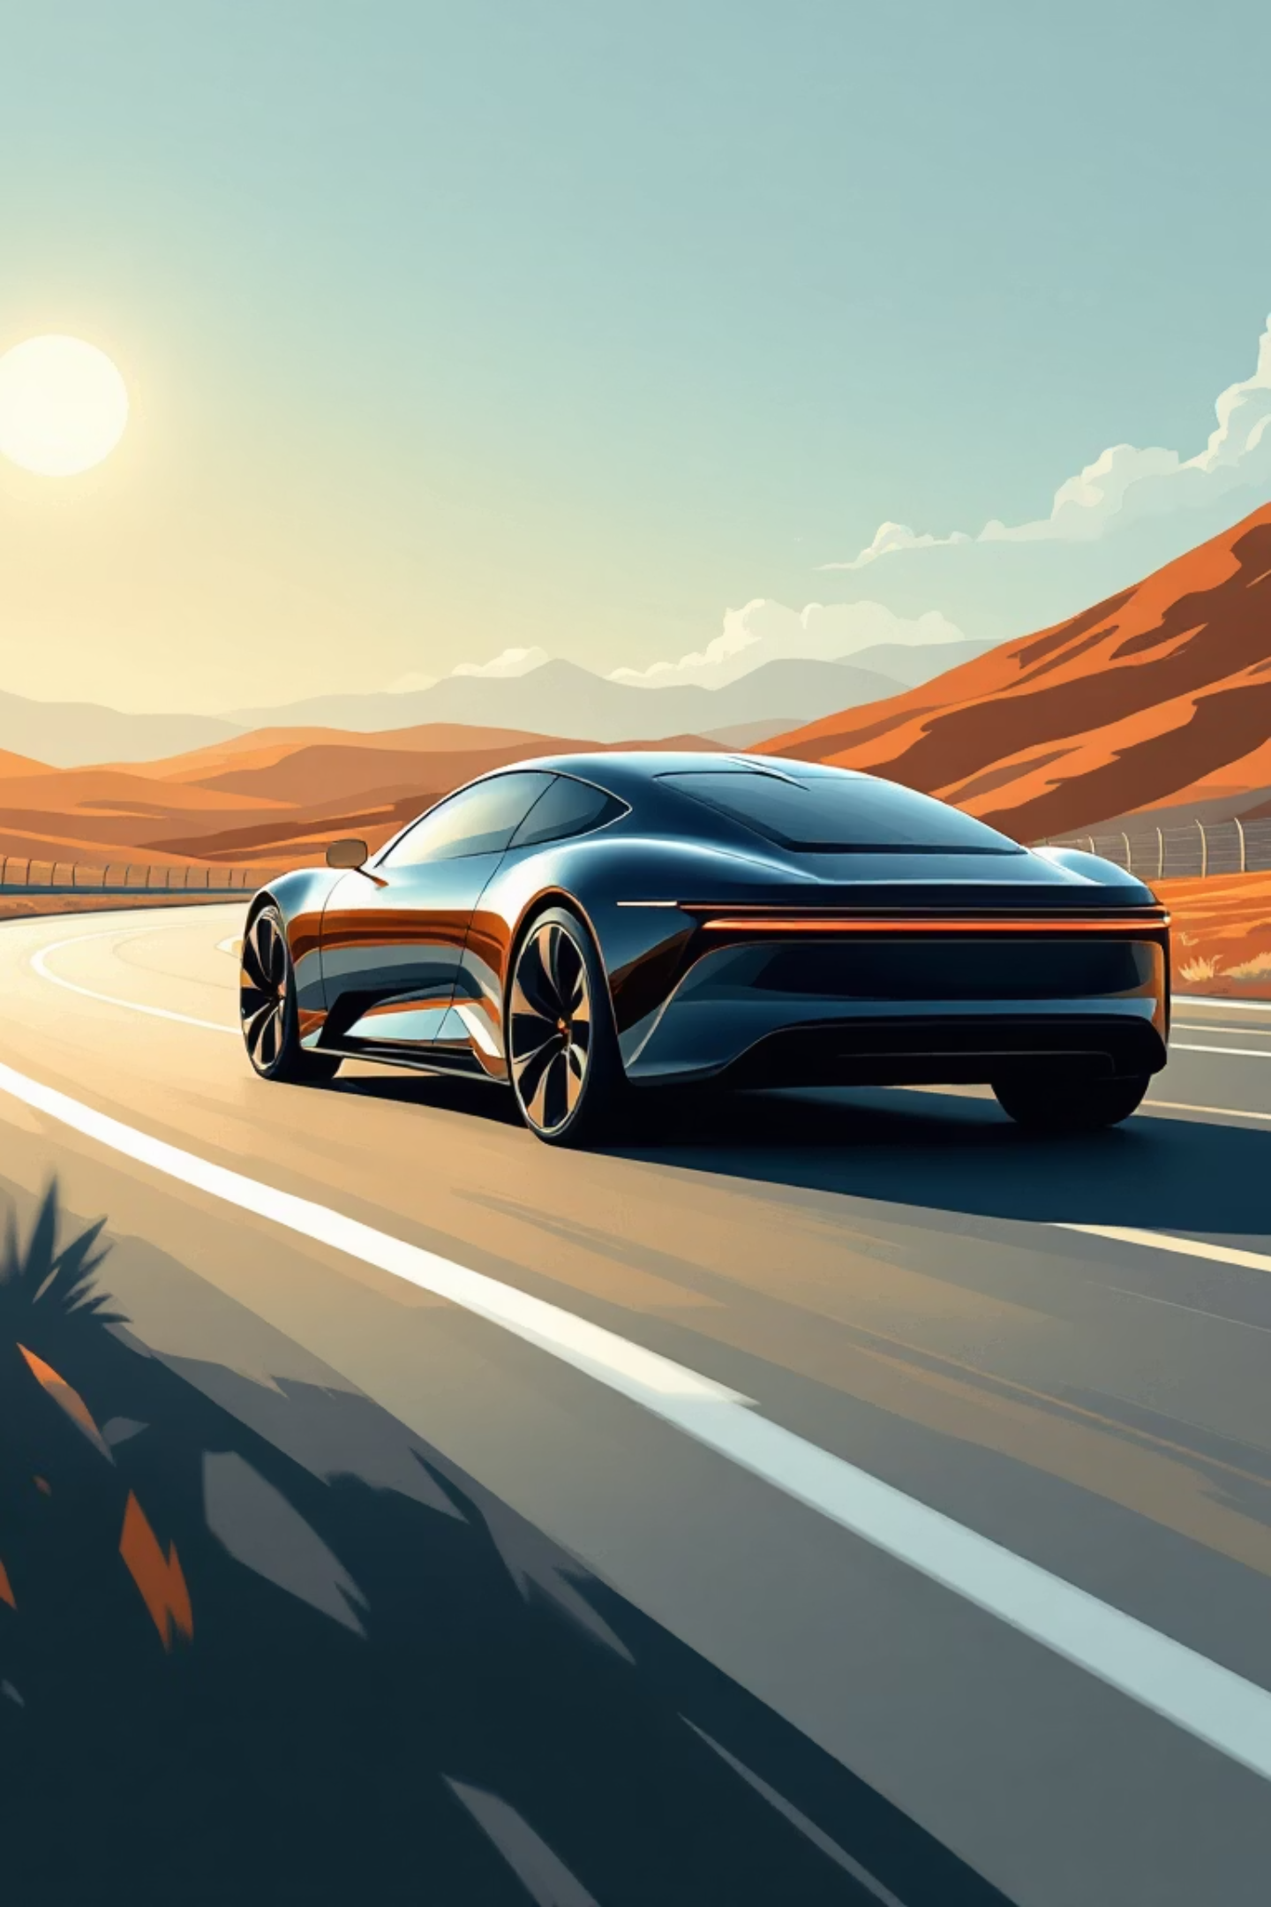



Driving Innovation: Your Wi-Fi Car Project
Discover the exciting world of embedded systems and IoT through the development of a Wi-Fi controlled car. This presentation will navigate the journey from concept to creation, offering practical insights and key takeaways.
Project Scope & Architecture
Embedded Systems & IoT Impact
Explore the comprehensive overview of the car's design, covering essential hardware components and software logic.
Understand why this project is a powerful hands-on example for mastering embedded programming and connected device principles.
Valuable Skills Gained
Learn core principles of motor control, network communication, firmware development, and practical debugging strategies.

Slide 2
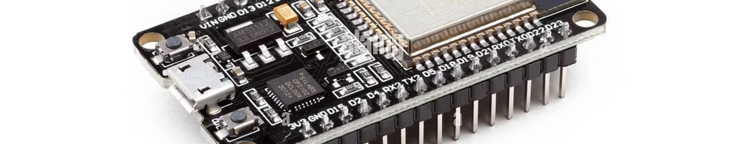
Wi-Fi Controlled Car using ESP32
Engineering-Level Project Presentation with Literature Survey and Detailed Implementation

Slide 3
Overview / Objectives
Remote Controlled Car
Smartphone Wi-Fi Interface
Design and implement a remote-controlled car using ESP32 and L298N motor driver.
Develop a user-friendly Wi-Fi application interface for control via smartphone or web browser.
Motion Control
Embedded Programming & Wireless Communication
Implement comprehensive motion control functionalities: forward, backward, left, right, and stop.
Gain practical experience in embedded programming and wireless communication protocols.
IoT Integration in Robotics
Practical ESP32 Application
Understand the principles of IoT integration within robotics applications and automation.
Apply ESP32 microcontroller knowledge to a tangible, real-world automation project.

Slide 4
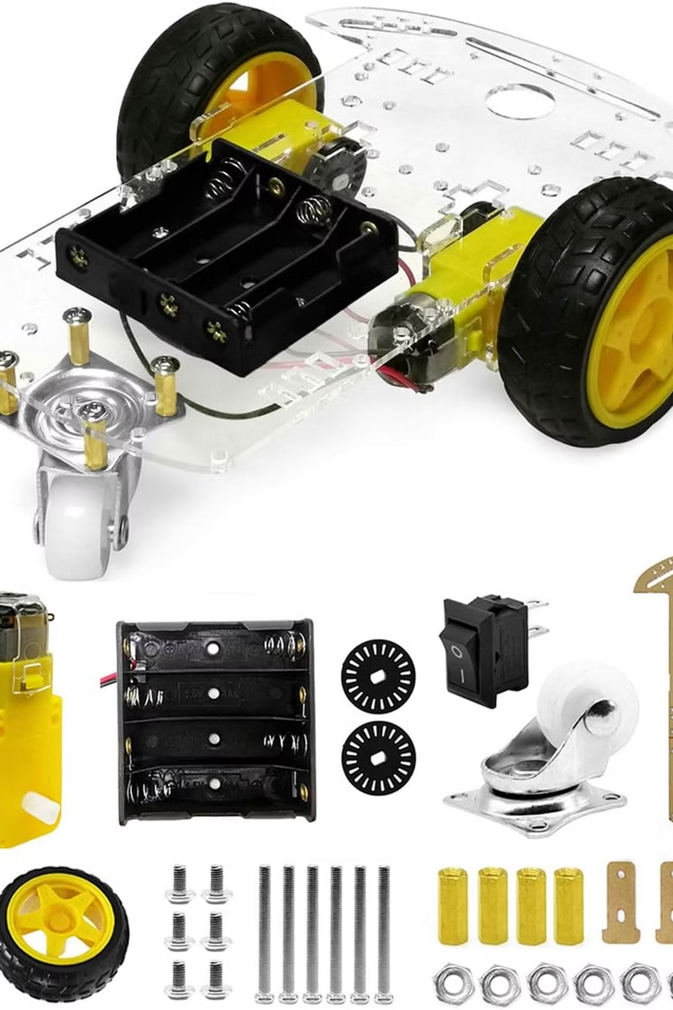
Components (Hardware)
1
ESP32 Development Board
Powerful microcontroller with built-in Wi-Fi for wireless communication and control.
2
4 × DC Motors + Chassis
Provides mobility with four DC motors and a sturdy frame for the car assembly.
3
L298N Motor Driver Module
Dual H-Bridge for precise speed and direction control of the DC motors.
4
Battery Pack
7.4–12 V battery pack to power the motors and ESP32.
5
Jumper Wires, Switches, Connectors
Essential for circuit connections, power control, and component integration.
6
Smartphone (Android)
Used as the remote control interface via a dedicated Wi-Fi application.
7
Optional: Ultrasonic or IR Sensors
For obstacle detection, enhancing autonomous navigation capabilities.
8
Optional: ESP32-CAM
Integrates a camera module for live video streaming and FPV control.

Slide 5
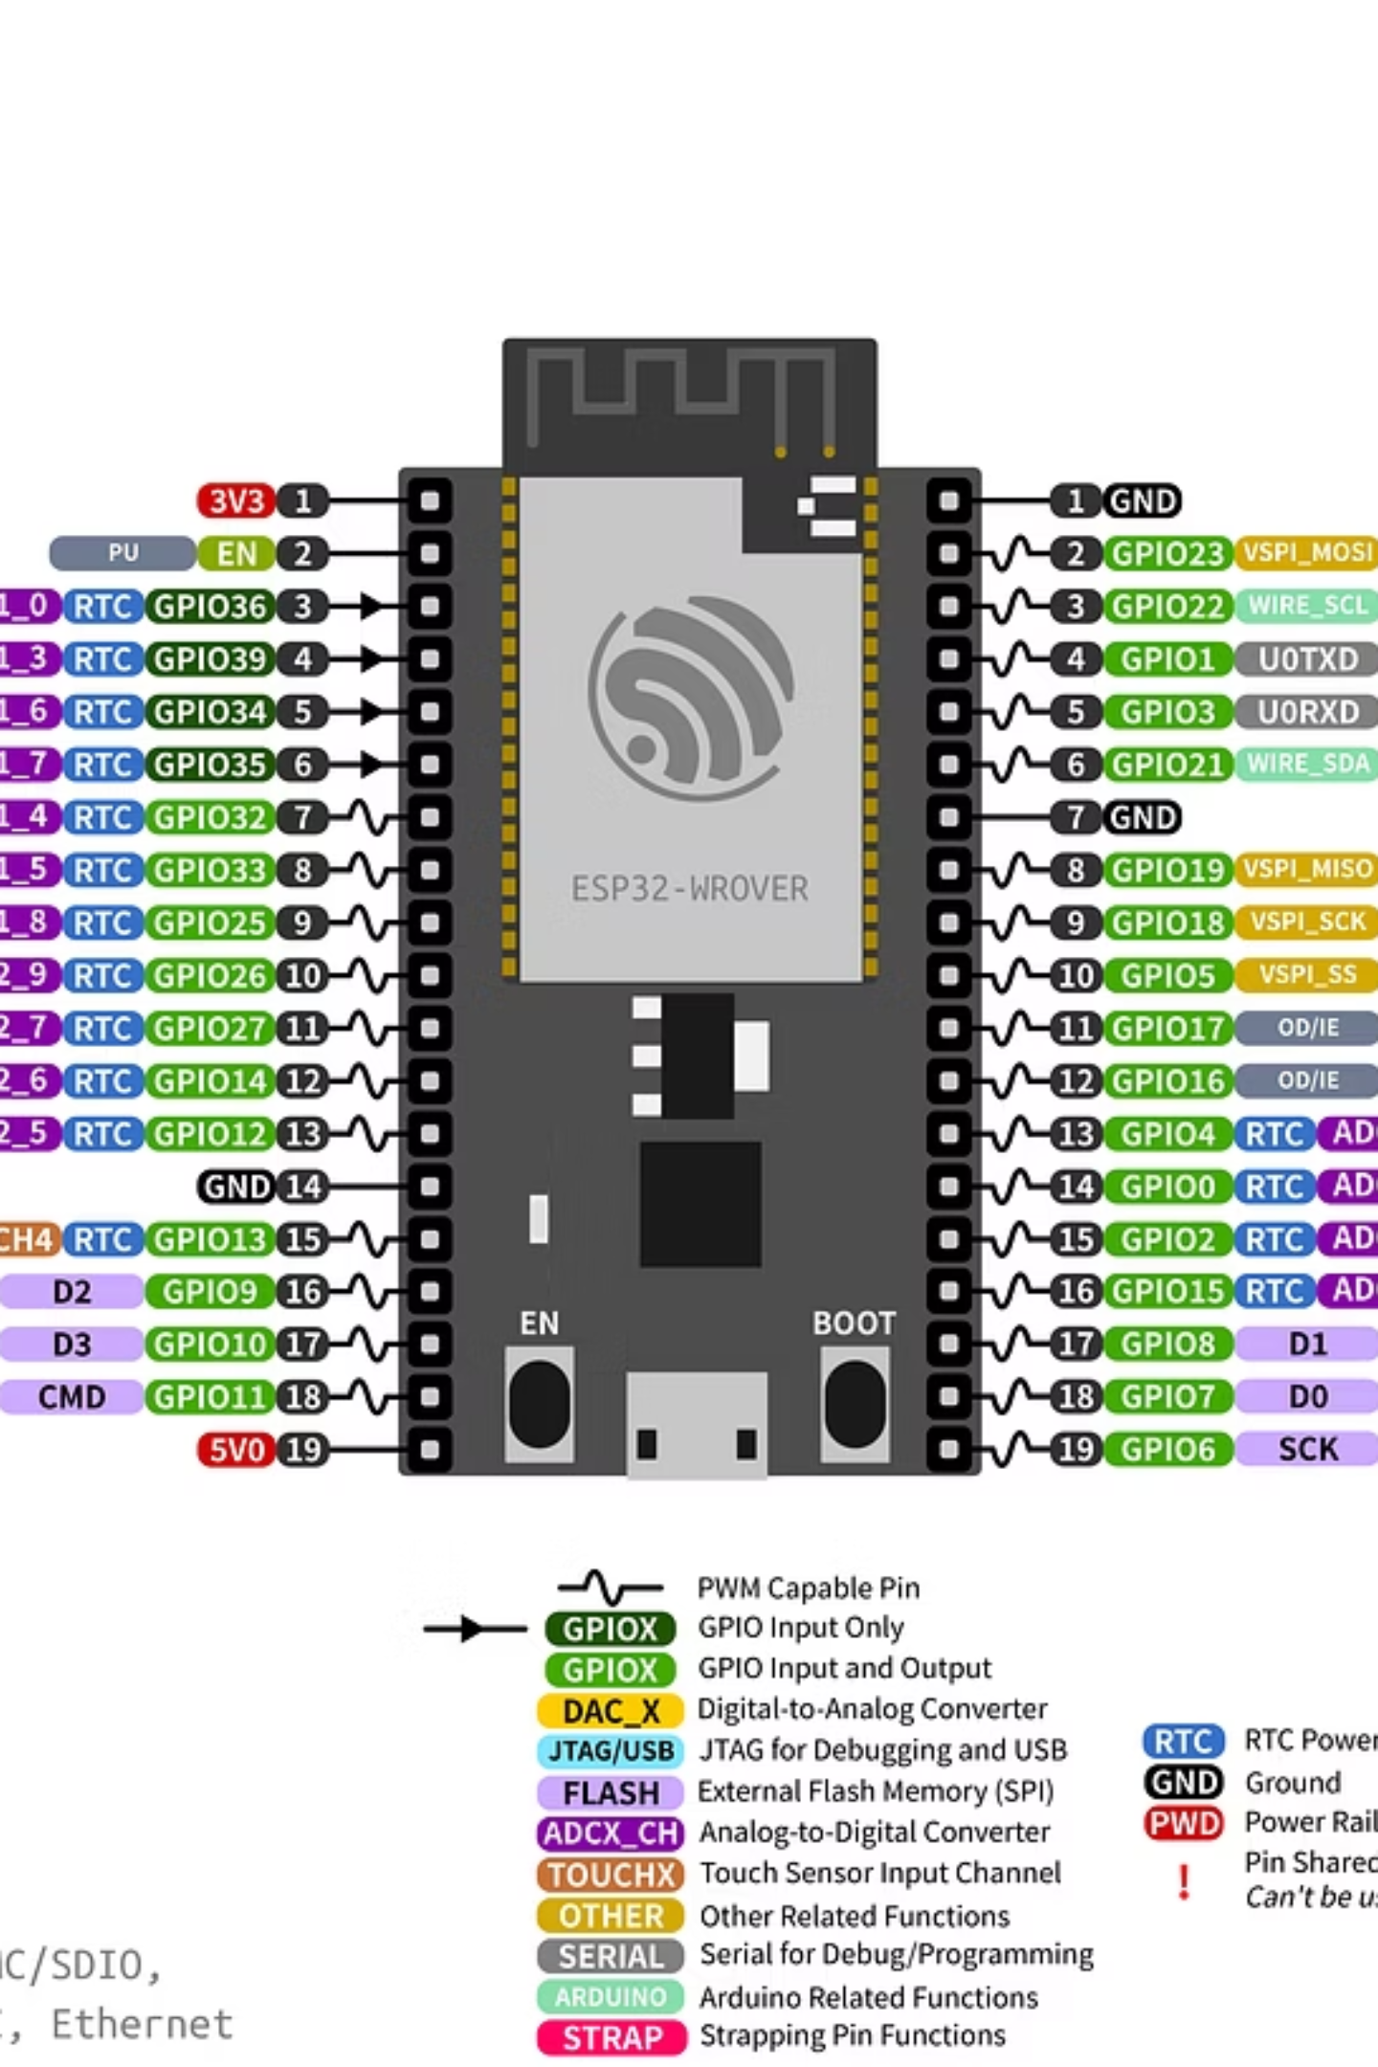
Components (Software & Tools)
Arduino IDE (for ESP32 programming)
Android APK (NodeMCU_Car.apk)
Serial Monitor (for debugging)
Fritzing (optional, for wiring diagrams)
Libraries: WiFi.h, ESPAsyncWebServer.h
Optional: Camera library (for ESP32-CAM)

Slide 6
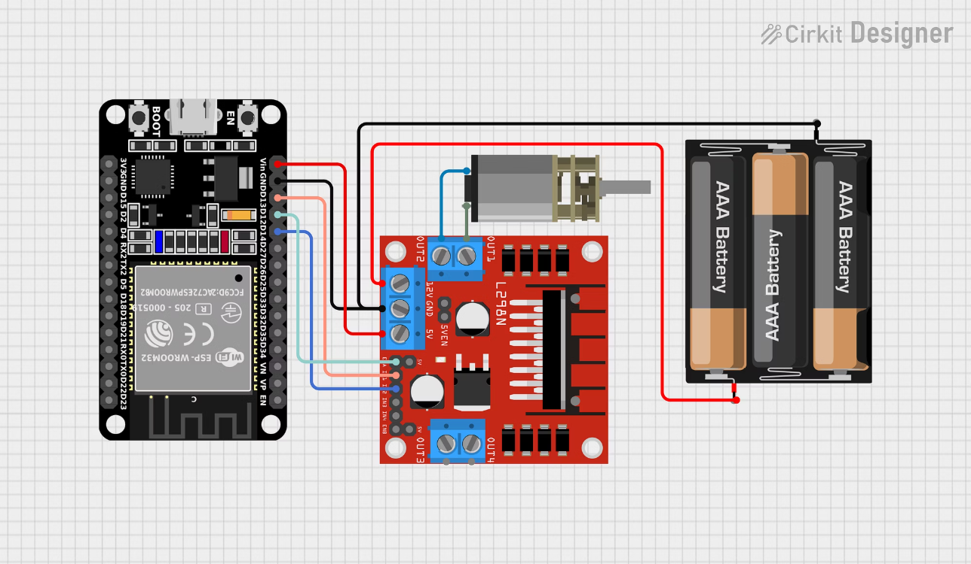
Pin Connections
Connection Details
01
02
ESP32 to L298N
Battery to L298N
Connect L298N's ENA, ENB, IN1–IN4 to designated ESP32 GPIO pins
Connect the power source (battery) to the L298N VIN terminal
03
04
Common Ground
Optional: Sensor Connections
Establish a common ground connection between ESP32 and L298N for stable operation
If applicable, connect sensor pins to available ESP32 GPIOs

Slide 7
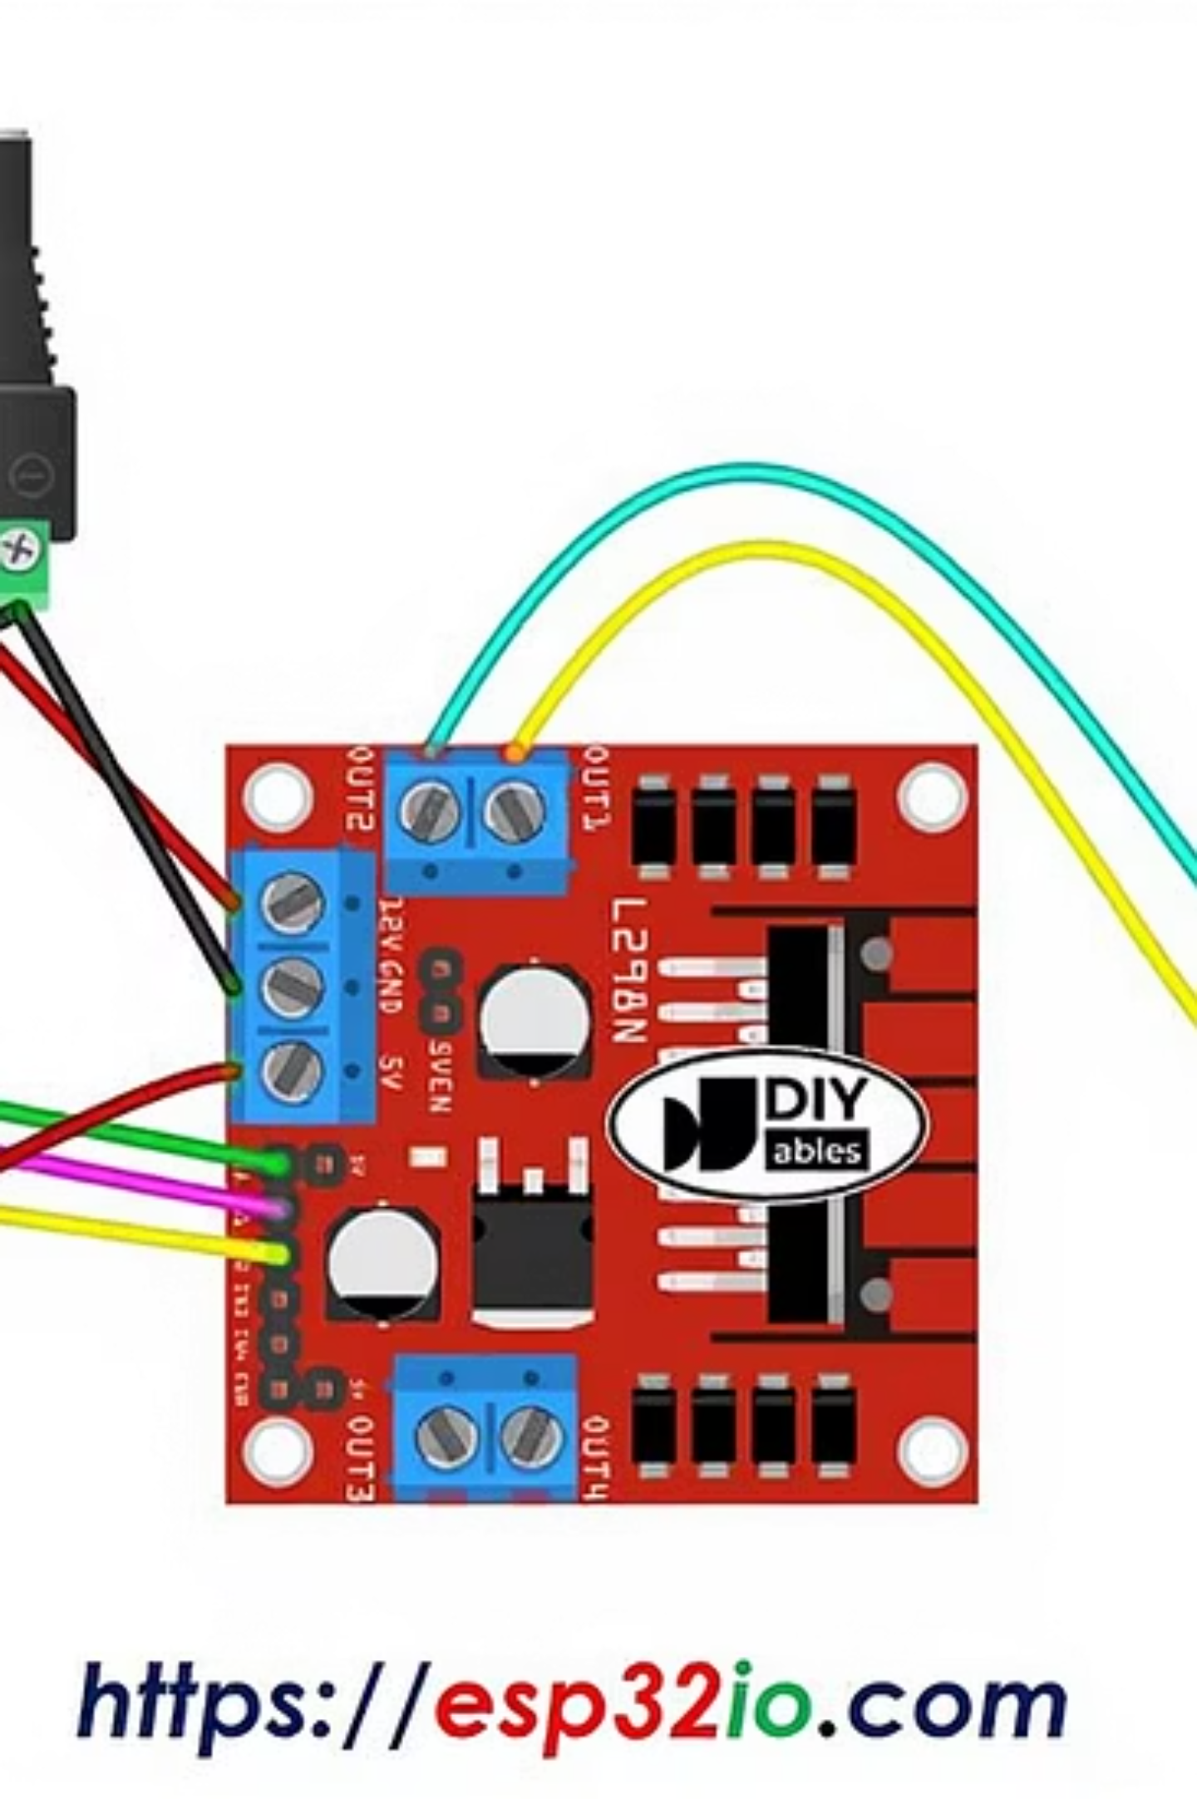
Code Overview
Wi-Fi Initialization
Initialize Wi-Fi connection and obtain the ESP32's IP address.
ESP32 Server
Set up an ESP32 server to receive commands from the control application.
Command Mapping
Map received commands to appropriate motor driver GPIO signals for movement control.
Optional Integrations
Integrate camera or additional sensors as required for advanced functionality.
Serial Monitor Debugging
Utilize the Serial Monitor for real-time debugging and status updates.
Safety & Stop Conditions
Implement essential safety checks and define stop conditions for secure operation.

Slide 8
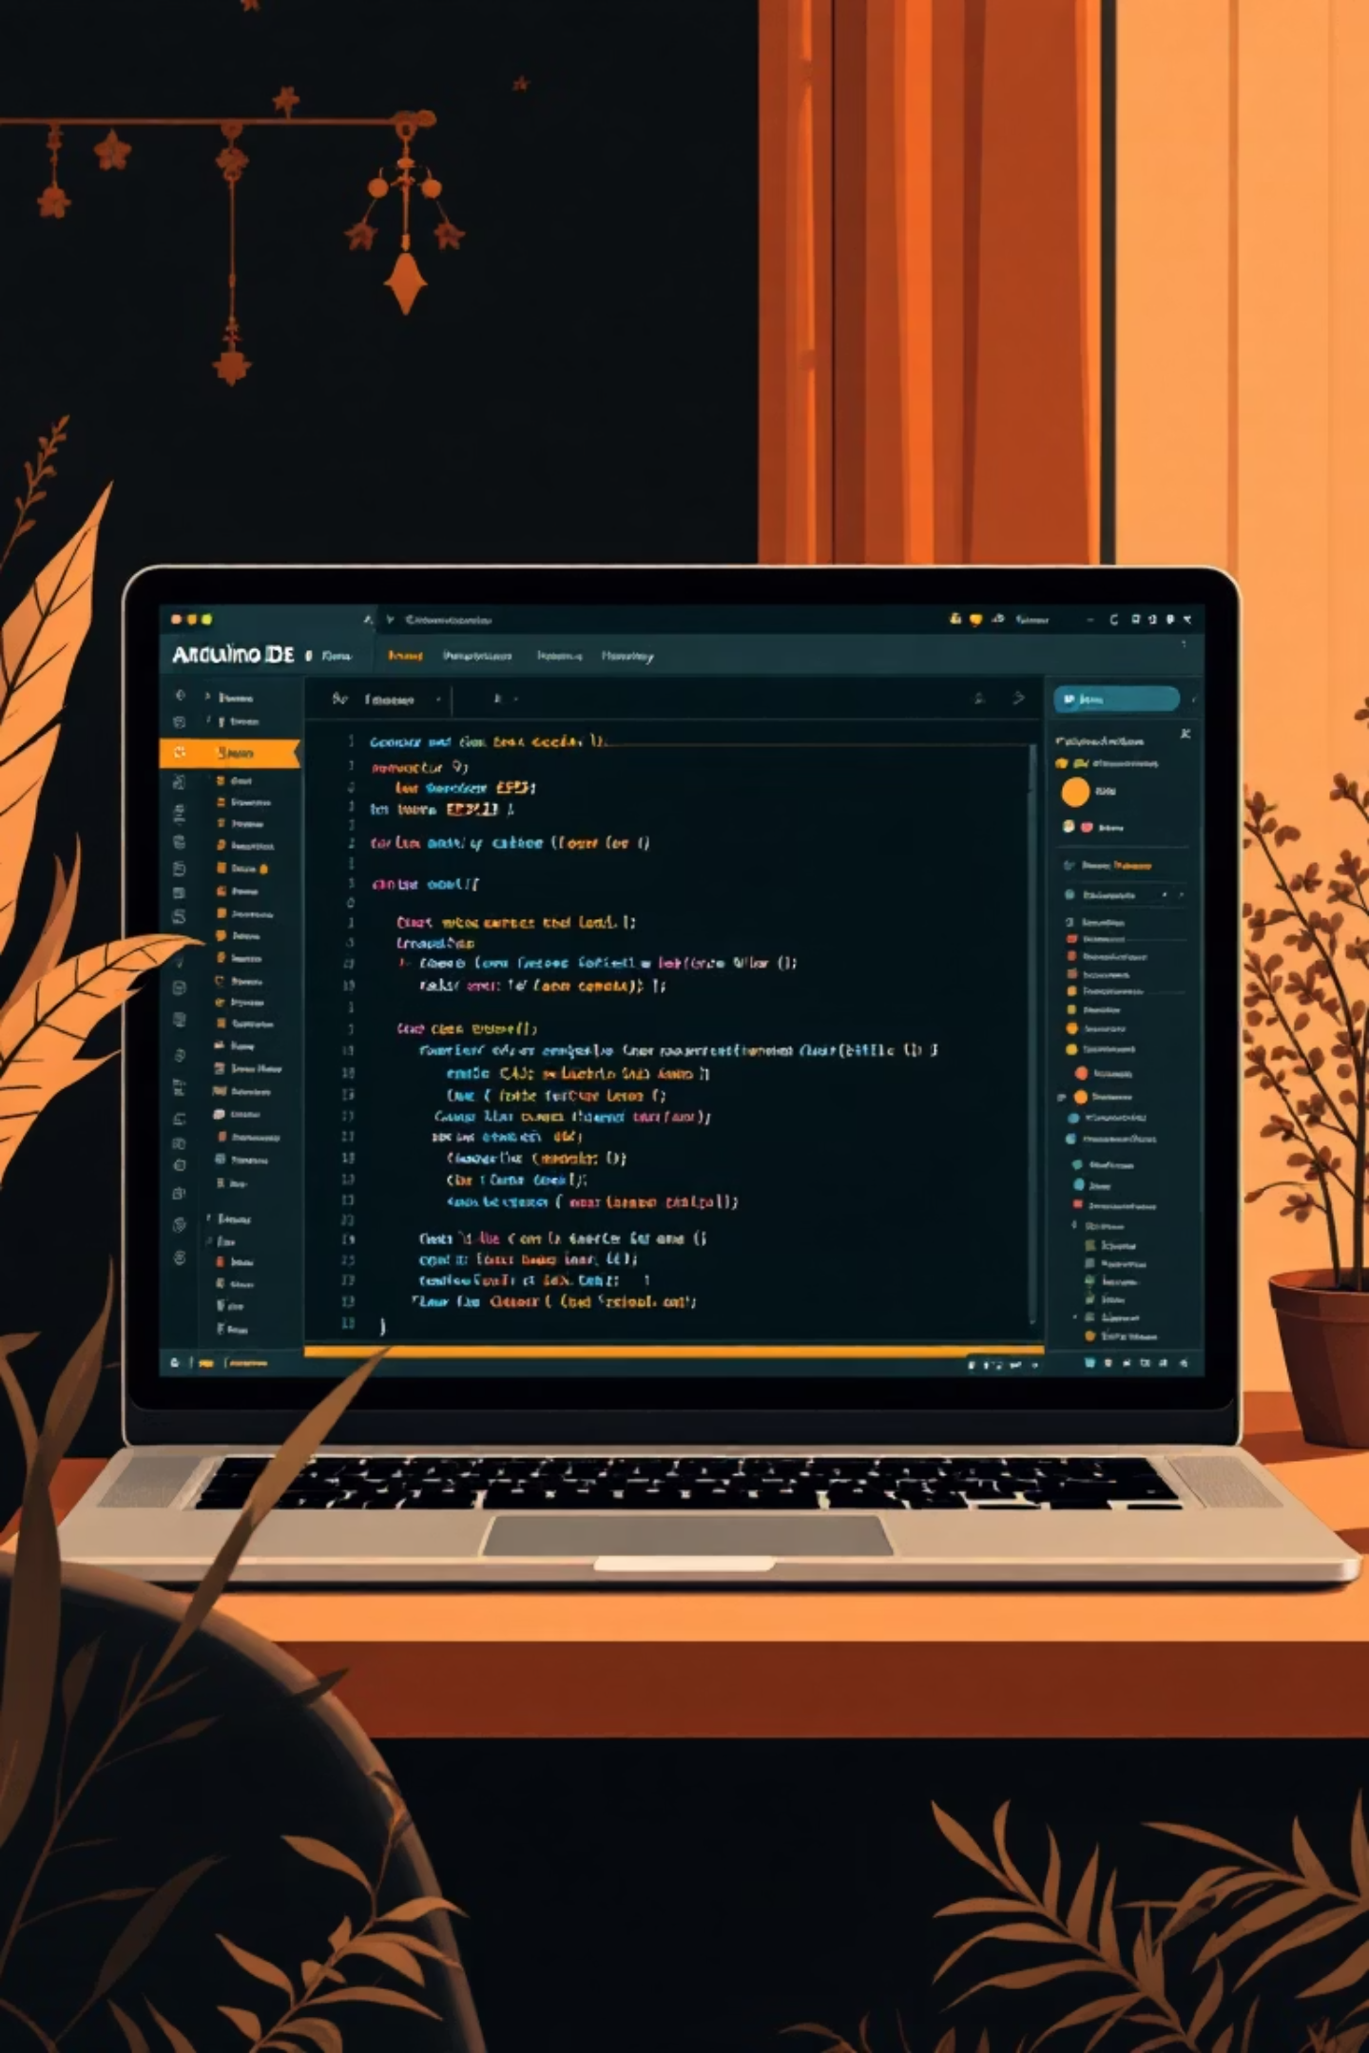





App / User Interface
ESP32 IP Connection
Movement Control Buttons
Connect the mobile application to the ESP32's IP address over the local Wi-Fi network.
Dedicated buttons for Forward, Backward, Left, Right, and Stop commands for intuitive navigation.
Real-time Command Interpretation
Optional Status Display
Display real-time IP address, connection status, and battery level for enhanced user experience.
ESP32 interprets and executes commands from the app in real-time for responsive control.
Advanced Control Options
Integrate optional swipe gestures or a joystick for more nuanced and dynamic robot control.
The user interface provides intuitive controls to send commands to the ESP32, enabling real-time navigation and interaction with the robot.

Slide 9

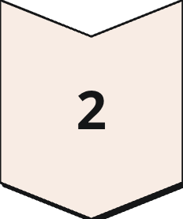
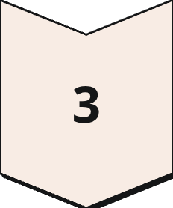
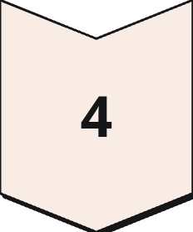


System Flow
User Input
Commands from user interface (e.g., buttons, joystick).
Wi-Fi Communication
Wireless transmission of commands over local network.
ESP32 Microcontroller
Receives and processes commands in real-time, integrating optional sensor feedback for obstacle avoidance.
L298N Motor Driver
Translates ESP32 signals into appropriate power for motors.
DC Motors
Receive power from the driver, generating rotation.
Car Movement
Physical execution of the commanded actions.

Slide 10
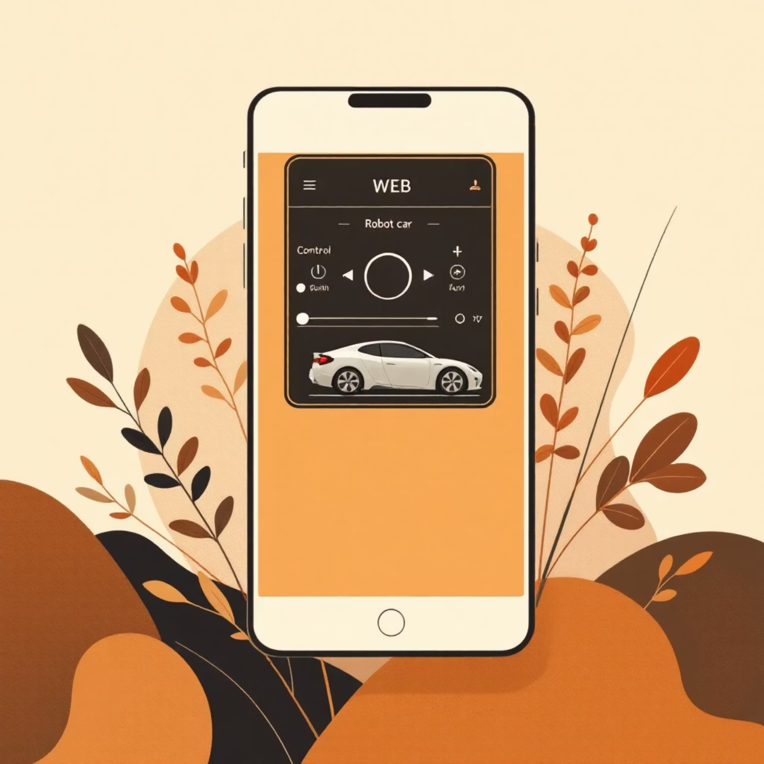
Testing & Demonstration
Testing Steps
01
Upload Code
Upload the control code to the ESP32 microcontroller.
02
Power Up
Connect and power the motors and the ESP32 controller.
03
Connect Smartphone
Connect your smartphone to the ESP32's Wi-Fi hotspot.
04
Test Motion
Thoroughly test all directional movements of the car.
05
Evaluate Performance
Observe the car's general performance, latency, and response time.
06
Optional Checks
If applicable, test integrated sensors or camera feed.

Slide 11
Challenges & Improvements
Challenges
Improvements
Wi-Fi latency
Upgrade motor driver
Battery voltage drop
Add sensors
L298N heating
Integrate ESP32-CAM
No obstacle detection initially
Optimize Wi-Fi/app communication
Implement power management

Slide 12

Literature Survey (Themes)
ESP8266/ESP32 Wi-Fi Robots
Explore existing designs and functionalities of remote-controlled robots leveraging ESP8266 or ESP32 for wireless communication.
Smartphone Apps vs Web Server Interfaces
Analyze the pros and cons of using dedicated smartphone applications versus browser-based web servers for robot control interfaces.
L298N vs TB6612 Motor Drivers
Compare the specifications, advantages, and limitations of different motor driver modules commonly used in small robotics projects.
Adding Sensors
Review the integration of various sensors (e.g., ultrasonic, IR) for enhancing robot capabilities like obstacle avoidance and autonomous navigation.
ESP32-CAM Integration
Investigate methods for integrating the ESP32-CAM module to enable live video streaming and First-Person View (FPV) control.
IoT in Small Robotics
Understand the principles and applications of Internet of Things (IoT) concepts within the context of small-scale robotic systems.

Slide 13






Literature Survey (Insights)
ESP32 Widely Adopted
ESP32 is a popular choice for wireless communication and control in robotics projects.
Motor Driver Comparison
L298N is cost-effective but less efficient; TB6612 offers superior performance and efficiency.
Sensor Integration
Adding sensors significantly enhances robot control, safety, and autonomous capabilities.
ESP32-CAM Benefits
The ESP32-CAM module provides live video streaming, enabling First-Person View (FPV) control.
Smartphone App Trade-offs
Smartphone applications offer convenience but can introduce latency in command transmission.
IoT in Robotics
IoT and Wi-Fi control paradigms are becoming standard in modern small-scale robotics.

Slide 14





Key Advantages
Low-Cost & Easy to Implement
Wireless Control, Compact, Portable
Scalable with Sensors/Cameras
Educational Project for IoT/Robotics
Real-time Motion Control with Feedback

Slide 15
Disadvantages
Limited Wi-Fi range
L298N inefficient → heat/power loss
The range of wireless control is constrained by Wi-Fi signal strength, potentially limiting operational area.
The L298N motor driver is known for being less efficient, leading to significant heat generation and power loss during operation.
Battery-dependent runtime
No obstacle detection initially
Operational time is directly limited by battery capacity and discharge rate, requiring frequent recharging or replacement.
The basic setup lacks sensors for autonomous obstacle detection, requiring manual navigation and increasing collision risk.
Network latency affects responsiveness
Manual control unless sensors added
Delays in Wi-Fi communication can impact the real-time responsiveness of the robot's controls, leading to slower reactions.
Without additional sensors, the robot relies solely on manual user input for all movements, limiting autonomous capabilities.

Slide 16







Future Scope
Upgrade motor drivers
Add ultrasonic/IR sensors
Integrate ESP32-CAM
Transition to more efficient motor drivers like the TB6612 for improved performance and reduced heat generation.
Integrate sensors for obstacle detection, enabling basic collision avoidance and environmental awareness.
Add a camera module for live video streaming, allowing for First-Person View (FPV) control and recording capabilities.
Develop advanced Android/iOS app
Voice control or cloud IoT integration
Multi-car swarm robotics
Create dedicated mobile applications for enhanced user experience, advanced controls, and a more robust interface.
Implement voice command functionality or integrate with cloud-based IoT platforms for remote control and data logging.
Expand the project to control multiple robot cars simultaneously, exploring swarm intelligence and coordinated movement.
Autonomous navigation using sensors
Develop algorithms for the robot to navigate environments independently, utilizing sensor data for pathfinding and decision-making.

Slide 17

Conclusion
We have successfully implemented a Wi-Fi controlled car, demonstrating a functional proof-of-concept for remote vehicle operation.
Through this project, we gained valuable experience in:
ESP32 programming
Wi-Fi server setup
Motor control
Existing literature supports various improvements and future enhancements for such robotics projects.
Future work will focus on:
Implementing better motor drivers
Integrating advanced sensors
Enabling live video streaming
Developing autonomous control capabilities
This project serves as a practical application in IoT and robotics, offering a solid foundation for further exploration and development.

Slide 18

References
seab3115 GitHub repository
ESP32 datasheet & Arduino core documentation
L298N / TB6612 motor driver datasheets
Tutorials: ESP32-CAM integration, IoT robotics, Wi-Fi controlled cars
Research papers on wireless robotic vehicles
IoT applications in small-scale robotics projects

